Slide 1
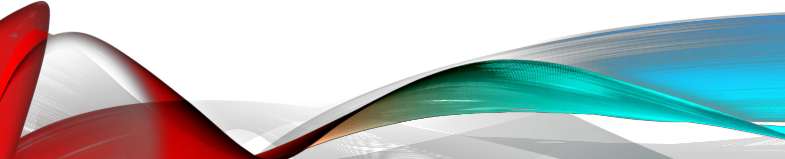
Chapter 6 Objects and Data structures

Slide 2
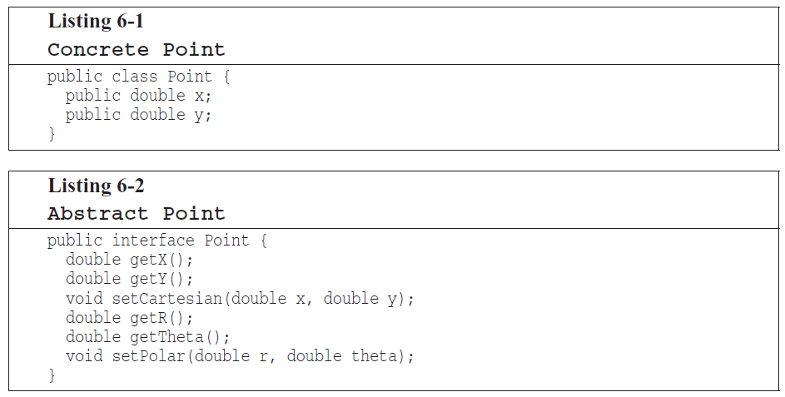
Data abstraction
Set coordinates in an atomic operation
Notes:
6-1 exposes its implementation and 6-2 hides it using functions
in 6-2 you must set the coordinates together as an atomic operation
We keep our vairables private to prevent unintended dependency on them, so that we can change implementation.

Slide 3
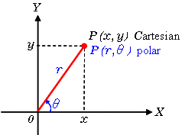
Data abstraction

Slide 4
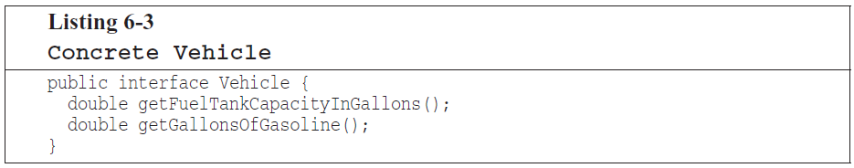
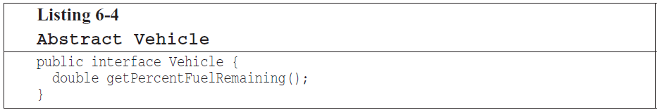
Data abstraction
Notes:
6-3 exposes detail of our data

Slide 5
Data/Object Anti-Symmetry
Object
Hide their data behind abstractions
Expose functions that operate on that data
Data Structure
Expose their data
Have no meaningful functions

Slide 6
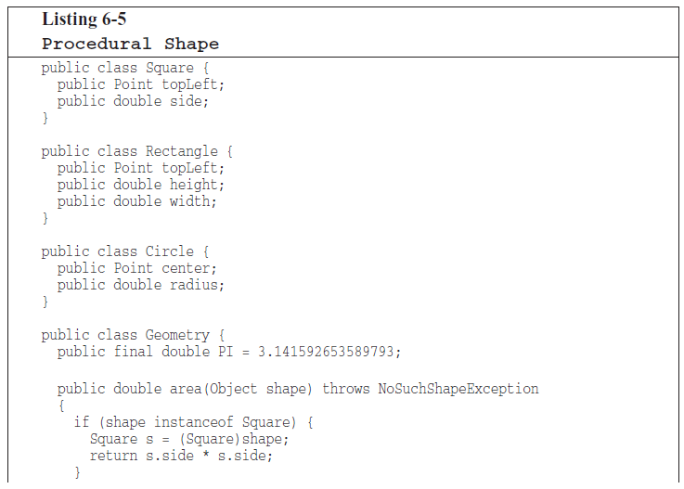
Notes:
The Geometry class operates on the three shape classes. The shape classes are simple data structures without any behavior.

Slide 7
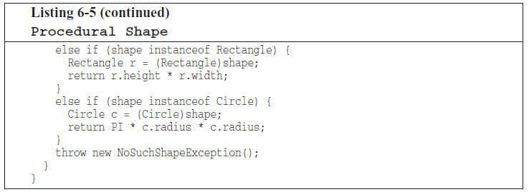
Data/Object Anti-Symmetry
Notes:
(perimeter = محیط, area = مساحت)
what would happen if a perimeter() function were added to Geometry ?
- anything depended on shape classes would be unaffected
what if we add a new shape ?
- we must change all of the functions in Geometry

Slide 8
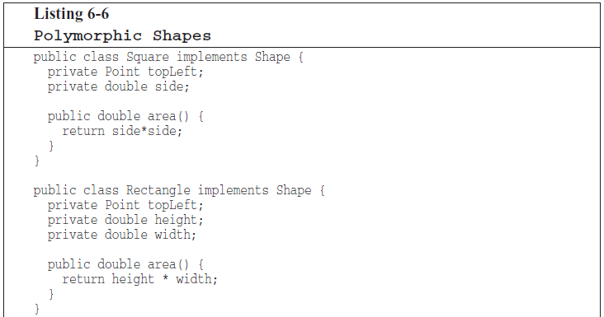
Data/Object Anti-Symmetry
Notes:
object-oriented solution of same concept without Geometry class

Slide 9
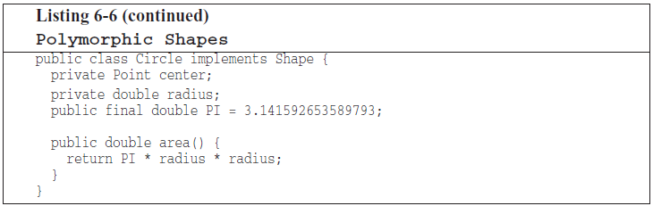
Data/Object Anti-Symmetry
Notes:
if I add a new shape, none of the existing functions are affected
if I add a new function all of the shapes must be changed!

Slide 10
Procedural code
easy to add new functions without changing the existing data structures
hard to add new data structures because all the functions must change
Object-Oriented
easy to add new classes without changing existing functions.
hard to add new functions because all the classes must change.
Notes:
Mature programmers know that the idea that everything is an object is a myth.

Slide 11
The law of Demeter
a method f of a class C should only call the methods of these:
C
An object created by f
An object passed as an argument to f
An object held in an instance variable of C
Notes:
The method should not invoke methods on objects that are returned by any of the allowed functions.
talk to friends, not to strangers.

Slide 12
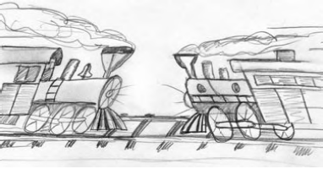

Train Wrecks
Notes:
If they are objects, then their internal structure
should be hidden rather than exposed, and so knowledge of their innards is a clear violation of the Law of Demeter.
If they are just data structures with no behavior,
then they naturally expose their internal structure, and so Demeter does not apply.

Slide 13
Hybrids
Half object and Half data structure.
They have functions that do significant things
They have public variables or public accessors and mutators
Difficulty??
make’s it hard to add new functions
make’s it hard to add new data structures
Notes:
Talk about God objects like Activity in old android world

Slide 14
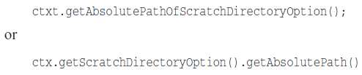
Hiding Structure
What if ctxt, options, and scratchDir are objects with real behavior?
How then would we get the absolute path of the scratch directory?
Notes:
The first option could lead to an explosion of methods in the ctxt object.
The second presumes that getScratchDirectoryOption() returns a data structure, not an object

Slide 15

Hiding Structure
Notes:
If ctxt is an object, we should be telling it to do something; we should not be asking it about its internals.

Slide 16
Data Transfer Objects
DTO
a data structure with public variables and no functions.
Bean
private variables manipulated by getters and setters.
Notes:
DTO and Bean classes are being used as mapping object to parse Json or get data from database

Slide 17
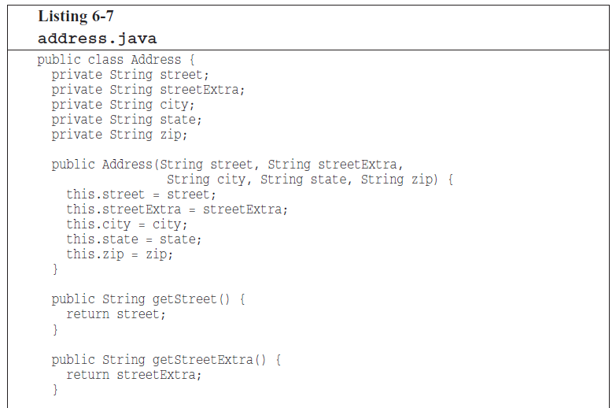
Data Transfer Objects
Notes:
This is a Bean class

Slide 18
Active record
Special form of DTO
Data structure with public variables alongside navigational methods like save and find
Example: Model classes in Laravel
Putting business rules into these classes make's it a Hybrid structure and hard to change.
Notes:
- Typically these Active Records are direct translations from database tables
- treat the Active Record as a data structure and to create separate objects that contain the business rules and that hide their internal data

Slide 19
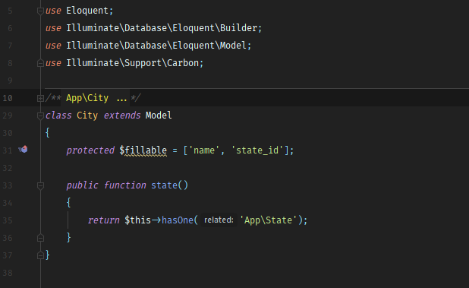
Active record

Slide 20
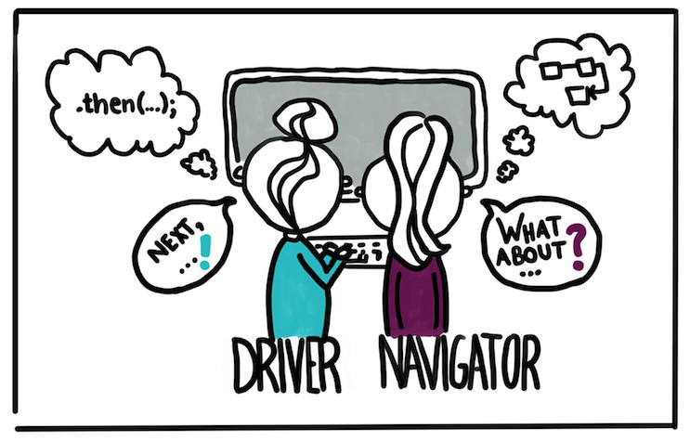
Vocabulary: Pair programming
Pair programming is an agile software development technique in which two programmers work together at one workstation.

Slide 21
Tool: CodeWithMe (Intellij) LiveShare (VsCode)
Collaborate on the same codebase without the need to synchronize code or to configure the same development tools, settings, or environment.
https://code.visualstudio.com/blogs/2017/11/15/live-share
https://www.jetbrains.com/help/idea/code-with-me.html

Slide 22
Thank You!

